Slide 1
Revision Record
Don’t Print This Page
COURSE CODE
PRODUCT
PRODUCT VERSION
COURSE VERSION
< COURSE CODE >
< PRODUCT NAME >
< VXXXRXXX >
1.01
DEVELOPER / MODIFIER
DATE
APPROVER
NEW / UPDATE
Nagaraj G
20111012
NEW

Slide 2
UAP3300 Basic Configuration [Command Line]

Slide 3

Agenda
UAP3300 configuration using Command Line
Configuring SIP Subscribers (SIPUE)
Configuring Access Code
Configuring UAP Boards
Configuring SIP trunk
Configuring PRI trunk
Configuring File Server
CTI Configuration
References

Slide 4
Objectives
Upon completion of this course, you will be able to:
Install and configure UAP3300

Slide 5

Training Pre Requisites
Knowledge on UAP Basics and its boards
CTI Basics and its components
Knowledge on PRI and SIP protocols
Configuration of Network File Server

Slide 6
Target Audience
This course has been designed for the audience who want to configure the UAP3300 system using CLI commands

Slide 7
Agenda
UAP3300 configuration using Command Line
Configuring SIP Subscribers (SIPUE)
Configuring Access Code
Configuring UAP Boards
Configuring SIP trunk
Configuring PRI trunk
Configuring File Server
CTI Configuration
References

Slide 8

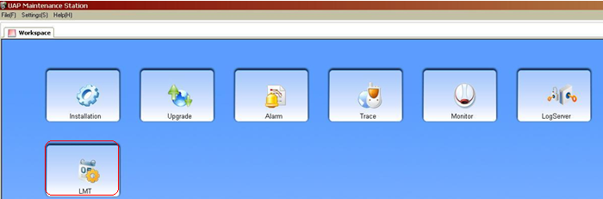
Methods of Commands Execution
Method 1: Open UAP Maintenance Station Client, Select the LMT option as shown above, Select UAP/ enter the UAP IP and can execute the following commands explained in the below presentation
Method 2: telnet using the UAP IP Address and executing the following commands. This presentation follows method 2.

Slide 9
UAP Basic Configuration
Start → Run → telnet < A.B.C.D >
Telnet to UAP using UAP IP Address
Login Name: admin
Password: xxxxxx
To Enter Configuration Mode:
[%UAP3300] en
Password: xxxxx
System ID Configuration of UAP [ Number of UAP]
The command is used to configure the number of the UAP3300
[%UAP3300(config)]# config modify sysmid mid 100 [ Range 1-253]
Domain name Configuration of UAP
The command is used to set the system domain name of the UAP3300
[%UAP3300(config)]# config system domainname <string>
Notes:
By default the UAP IP address will be different. Hence configure the IP as per network and IP planning !!

Slide 10
UAP Basic Configuration
UAP IP Configuration:
This command is used to configure the IP address and the subnet mask of the UAP3300
[%UAP3300(config)]# config system ip < A.B.C.D /M>
To Configure UAP Gateway:
This command is used to set the gateway IP address of the UAP3300
[%UAP3300(config)]# config system gateway ip < A.B.C.D >
To Configure Host IP Address:
This command is used to set the IP address of the load server of the UAP3300.
[%UAP3300(config)]# config system hostip <A.B.C.D>

Slide 11
UAP Basic Configuration
To See the UAP System Information
The command is used to query the system information
[%UAP3300(config)]# show system information
Device Type: UAP3300
DomainName: UAP3300
IP Address: 192.168.101.153
MAC Address: 00-05-3b-8c-01-01
GateWay IP Address: 192.168.101.1
SubMask: 255.255.255.0
Host IP Address: 192.168.101.76
CTISERVER IP Address:
Voice Code And Decode Type: G711A/G711U/G729/G723
Running Time: 0 Hours 17 Minutes
Current Time: Date:1999-11-30 Time:08:00:12
System Mid: 100
To Save the configuration:
This command is used to save the configuration to the UAP3300.
[%UAP3300(config)]# save
To Reboot UAP:
[%UAP3300(config)]# reboot

Slide 12
TAB KEY Function in Command Line Configuration of UAP3300
This section describes the method and tips of carrying out the CLI command, including:
􀁺 Complementing a Command
􀁺 Abbreviating a command
􀁺 Getting a command
Complementing a Command
You can press the Tab key to enable the function of complementing a command. That is, after entering some information and from which you can known the command, you can press the Tab key to complement the command.
􀁺 If several commands match the entered information, a list of the possible commands is shown for your choice.
􀁺 If only one command matches the entered information, it is complemented automatically in the command line. In this case, the cursor moves to the end of the command line.

Slide 13
TAB KEY Function in Command Line Configuration of UAP3300
Abbreviating a Command
You can enter a word of a command or the first few letters of the key word if the entered information is understood correctly.
For example, to display the device information, you can enter any of the following abbreviated commands:
􀁺 sh sys infor
􀁺 s s i
The preceding abbreviated commands map the full command of show system information
Getting a Command
You can enter the question mark ? to display the descriptive information (namely, the syntax of the command at the current position) of the CLI command. By getting the prompt information while you enter a command, you can complete the command line until you get a command that can be carried out.

Slide 14
Agenda
UAP3300 configuration using command Line
Configuring SIP Subscribers (SIPUE)
Configuring Access Code
Configuring UAP Boards
Configuring SIP trunk
Configuring PRI trunk
Configuring File Server
CTI Configuration
References

Slide 15
Configuring SIP Subscribers (SIPUE)
Step 1: Add Prefix:
This command config add prefix is used to make an outgoing call with callcategory type as basic and attribute as intertrunk call. Also predeal is not enabled. This means that no initial number will be truncated when making trunk calls.
[%UAP3300(config)]#config add prefix dn 6 callcategory basic callattribute inter cldpredeal no minlen 4 maxlen 4
==== Command executed success ! ====
[%UAP3300(config)]#
Step 2: Add Sip User:
This command batch adds 4 sip users starting from 6000 with noauthorization type specified.
[%UAP3300(config)]#con add batch sipue seid 6000 authorizationtype noauth number 4
==== Command executed success ! ====
[%UAP3300(config)]#
Notes:
Call Category: Type of Call <basic | new |intelligent | spl access code| ivr>
Call Attribute: Indicates the service attribute [Local call | Inter Call etc.,]
Cld Predeal : Indicates whether to change the called number
Seid: Indicates the start phone number
Authorization Type: Indicates the authentication type.
The values are as follows:
􀁺 noauth: no authentication.
􀁺 authbyip: authentication basedon IP.
􀁺 authbyeid: authentication basedon ID.
􀁺 authbyeidandip: authenticationbased on IP address and ID.

Slide 16
Configuring SIP Subscribers (SIPUE)
Step 3: To Display SIPUE
[%UAP3300(config)]# show sipue
Step 3: To Add Subscriber:
This command adds subscribers to call starting from 6000 upto 4 users
(This command creates sip users with phone number ranging from 6000 ~ 6003)
[%UAP3300(config)]#con add subscriber eid 6000 dn 6000 number 4
==== Command executed success ! ====
Step 4: To display the configured subscribers phone numbers:
[%UAP3300(config)]# show subscribers
Notes:
Eid: Starting Phone Number of SIP UE
Dn: Indicates the number of the start SIP subscriber

Slide 17
Agenda
UAP3300 configuration
Configuring SIP Subscribers (SIPUE)
Configuring Access code
Configuring UAP Boards
Configuring SIP Trunk
Configuring PRI Trunk
Configuring File Server
CTI Configuration
References

Slide 18
Access Code Configuration in UAP
Step 4 : Configuring the Access code 10086 in UAP3300
This prefix 10086 is termed as the Toll-Free number or Access number of the Call Center. When a Customer or User dials 10086, the number will be recognized as a toll-free/call center number and the call will be routed to the UAP3300 or to the call center for further handling.
The parameter Intess of Call Attribute determines the Access Number.
[%UAP3300(config)]# config add prefix dn 10086 callcategory intess callattribute inter cldpredeal no min 5 max 5
==== Command executed success ! ====
[%UAP3300(config)]#
Notes:
Is the toll free number.
If the Call Category is INTESS, it means this number will act as Toll Free number.

Slide 19
Agenda
UAP3300 configuration using Command Line
Configuring SIP Subscribers (SIPUE)
Configuring Access Code
Configuring UAP Boards
Configuring SIP Trunk
Configuring PRI Trunk
Configuring File Server
CTI Configuration
References

Slide 20
Boards Configuration in UAP
Adding the MRS Board:
Config add board slot no <2-9> type mrs mrsip <a.b.c.d/m> gatewayip <a.b.c.d> workmode <mix|vp|cp>
slot <2-9>: Indicates the slot number of the UAP-MRS.
mrsip <a.b.c.d/m>: Indicates the IP address of the Ethernet interface on the UAP-MRS.
gatewayip <a.b.c.d>: Indicates the gateway IP address of the Ethernet interface on the UAP-MRS
workmode <mix | cp |vp>: Indicates the working mode of the UAP-MRS. The values are as follows:
mix: 24 voice peripheral (VP): channels and 24 conference peripheral (CP) channels
vp: 40 VP channels and no CP channel
cp: 30 CP channels and no VP channel

Slide 21
Agenda
UAP3300 configuration using Command Line
Configuring SIP Subscribers (SIPUE)
Configuring Access Code
Configuring UAP Boards
Configuring SIP trunk
Configuring PRI trunk
Configuring File Server
CTI Configuration
References

Slide 22
SIP Trunk Configuration in UAP
A trunk is an interconnection between 2 UAPs. The following configurations need to be done on both the UAPs that form the trunk.
SIP Trunk Configuration in UAP-1:
Configure domain name for the UAP-1
config system domainname uap142
Add the domain name & IP address of UAP-2 in UAP-1 to form the trunk.
This command is used to add a peer office device.
config add peercomponent domainname uap152 ip <A.B.C.D> tkcnum 30
Add an office select code for creating an office number:
The command is used to add office direction selection codes.
config add office selectcode 4 repeatroute no
Notes:
Here we have chosen to name the domain based on the IP of the UAP to identify it uniquely.
Here we are adding the UAP at IP <A.B.C.D> as the other end of the trunk, having domain name uap152, specifying that number of trunk circuits is 30 (2 out of 32 used for signaling).
Repeatroute: Indicates whether to support rerouting.

Slide 23
SIP Trunk Configuration in UAP
Add office based on above select code, for trunk calls
The command is used to add an office direction.
config add office no 4 officeselectcode 4
Specify protocol of communication to be used for the trunk calls
The command is used to set the SIP protocol, including the office number of the trunk group, the added peer office component name, the signaling port number of the SIP protocol of the peer office, and the maximum call number bore by the trunk group
config protocol sip officeno 4 domainname uap152 peerport 5060 maxcallnum 30
Office No: Indicates the office number of the trunk group
Domainname: Indicates the domain name of the added peer office component.
Peerport: Indicates the signaling port number of the SIP protocol of the peer office.
MaxCallNum: Indicates the maximum call number born by this trunk group.
Notes:
Here we are choosing to use SIP protocol for trunk call setup, for office 4 created above, from local UAP (uap142) with remote UAP (uap152) at port 5060 of uap152 with a maximum of 30 calls possible.
The maxcallnum value should be equal to or lesser than the tkcnum parameter configured while adding peercomponent.

Slide 24
SIP Trunk Configuration in UAP
Command to add Predeal:
The command is used to add the index for changing the number.
config add predeal index 1 changetype delete changepos 0 changelen 2
Add a new prefix to identify these trunk calls
config add prefix dn 80 callcategory basic callattribute local cldpredeal yes cldindex 1 officeselectcode 4 min 2 max 24
Save the config changes to UAP3300
save
To View the trunk circuit setup
show tkc office no 4
Note: Similar Configuration has to be done at the UAP-2 side to form the trunk
Notes:
If predeals are already configured, the same can be viewed using the command:
Show predeal
changetype : Indicates the change type: insert/modify/delete.
changepos : Indicates the change position.
changelen : Indicates the change length.

Slide 25
Agenda
UAP3300 configuration using command line
Configuring SIP Subscribers (SIPUE)
Configuring Access Code
Configuring UAP Boards
Configuring SIP trunk
Configuring PRI trunk
Configuring File Server
CTI Configuration
References

Slide 26
PRI Trunk Configuration in UAP
PRI Trunk Configuration:
Add a new selectcode for a new office to be configured for trunk calls
config add officeselectcode 3 repeatroute no
Add a new office for trunk calls
config add office no 3 officeselectcode 3
Add DTU board
config add board slot 3 type dtu officeno 3
config modify board slot 3 type dtu trunkport 0 signallingtype pra
Add PRA protocol
config protocol pra officeno 6 selectlinemode poll
Configure one of the card slots to be used for trunk dialing
config add pralink linkno 0 slot 3 trunkport 0 position network ts 16
Notes:
Here we have given the code 3 to the office to be used for trunk dialing.
Repeatroute 0 means we do not wish to enable re-routing of calls to any other party in case of failure.
Here we are adding office number 3 identified by the selectcode 3.
Selectlinemode: Indicates the mode for selecting the line. The values are as follows:
􀁺 sortasc: minimum line-selecting mode
􀁺 sortdrop: maximum line-selecting mode
􀁺 poll: poll selection
The maximum line-selecting mode indicates to select from the circuit with max. No. in the
line-selecting queue; the minimum line-selecting mode indicates to select from the circuit
with min. No. in the line-selecting queue.

Slide 27
PRI Trunk Configuration in UAP
Add a preprocessing case to remove the configured prefix to be dialed for making trunk calls
config add predeal index 2 changetype delete changepos 0 changelen 2
View the predeal details set:
show predeal
Add the prefix to the dialed number that uniquely identifies a trunk call
Config add prefix dn 80 callcategory basic callattribute local cldpredeal yes cldindex 2 officeselectcode 3 min 2 max 24
View the newly added prefix info
show prefix
Save the config
save
Notes:
Here we are choosing to configure trunk on 3rd card slot, having EUD type of card, assigned to office with code 3.
Trunkport 0 means that we have connected the E1 cables for trunk call at the 1st E1 slot (index = 0) on this EUD card.
TS 16 means that the 16th time slot in TDM will be used for signaling.
Note: Instead of network, we can also give user. In the test environment used here, both the UAPs are configured with users.
Note:
The “State” field’s value should be “OK”. The lights are green and steady (not flashing) for normal operation (state = OK).
The state “SLIP” indicates loose connection of cables – indicated on hardware by flashing green lights.
If it shows “LOS”, it means there is some other error – this is also indicated on the hardware board in UAP by an orange light.
Here we are asking the UAP to preprocess trunk calls (this pre-deal scenario will be uniquely identified by the index 2), by deleting 2 digits (changelen 2) starting from the position 0 of the dialed number (changepos 0).

Slide 28
Agenda
UAP3300 configuration using command line
Configuring SIP Subscribers (SIPUE)
Access Code configuration
Boards Configuration
SIP trunk configuration
PRI trunk configuration
File Server Configuration
CTI Configuration
References

Slide 29
File Server Configuration in UAP
The command is used to add a network file server (NFS). The NFS can connect to the UAP-MRS to store the voice playing files and voice recording files of the UAP-MRS.
Alternatively, the NFS can connect to the UAP-Main Control Unit (UAP-MCU) to store the call detail record (CDR) files required by the traffic statistics function of the UAP3300 trunk.
config add nfs type <mrs|bill> nfsno <0-1> nfsip <a.b.c.d> remotedir <string> localdir <string>
Nfsno<0-1>: Maximum 2 NFS servers can be configured.
<a.b.c.d>: IP address of the NFS server.
remotedir<string>: remote shared directory of NFS
Localdir<string>: indicated local drive letter mapping
Eg: config add nfs type mrs nfsno 0 nfsip 10.18.3.21 remotedir vpshare localdir y

Slide 30
Agenda
UAP3300 configuration using Command Line
Configuring SIP Subscribers (SIPUE)
Access Code configuration
Boards Configuration
SIP trunk configuration
PRI trunk configuration
File Server Configuration
CTI Configuration
References

Slide 31
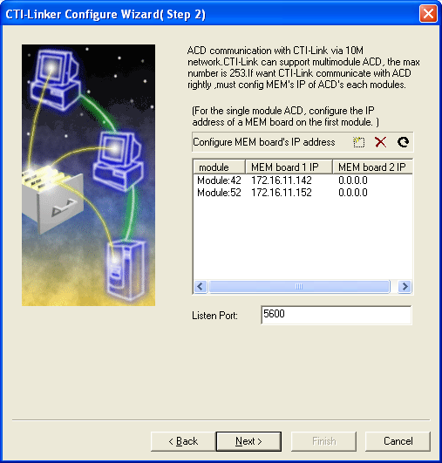
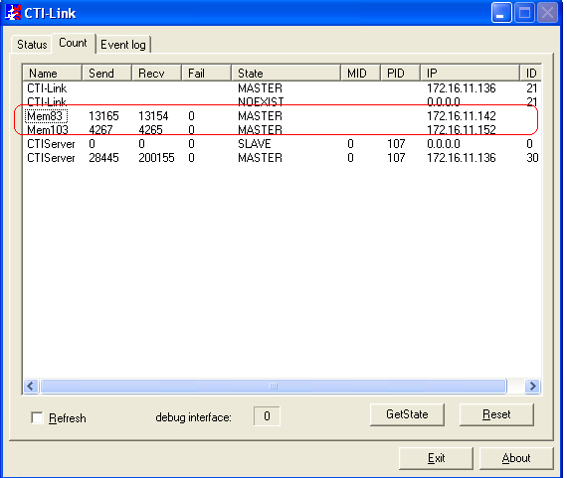
CTI Configuration in UAP
Add the CTI information in UAP. Give the CTI IP and port no. Port no must be the same as configured in CTI Link.
config add cti no 1 ip x.x.x.x port 5600
Also check the CTI link, whether the UAPs are UP and in MASTER mode.

Slide 32
Agenda
UAP3300 configuration using Command Line
Configuring SIP Subscribers (SIPUE)
Access Code configuration
Boards Configuration
SIP trunk configuration
PRI trunk configuration
File Server Configuration
CTI Configuration
References

Slide 33
References
Refer the attached document for commands and information on each parameter

